Slide 1
Augmenting Borda Count to Instant Runoff
By: Evan Liang

Slide 2
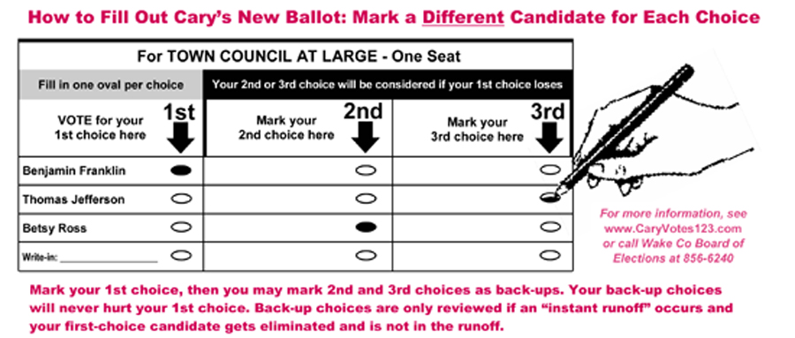
Borda Runoff
Eliminates candidates based on the Borda Count

Slide 3
Motivation
I like runoff voting systems, but monotonicity is also unbearable
Variations of instant runoff
Measuring monotonicity

Slide 4
Properties of BRV
Trivial: Satisfies anonymity and neutrality.
Nontrivial: satisfies the majority criterion.
Does not satisfy monotonicity and CWC

Slide 5
Lemma about Borda count
If a candidate receives the majority of first place votes in an election, then that candidate cannot be last place under Borda count.

Slide 6
Monotonicity
Winner Vulnerability: an election is vulnerable if increasing the winner’s ranking on some individual preference orders results in a new winner.
General Vulnerability: an election is vulnerable if we can find a candidate whose ranking on the societal preference order is lowered when its ranking is increased on some individual preference orders.

Slide 7
Results – 3 candidates

Slide 8
Results – 4 candidates

Slide 9
Results – cont.
BRV performs better than IRV in every test.
Question: if an election passes the vulnerability test for IRV, does the same election pass the test for BRV?
Answer: NO

Slide 10
References
Jonathan K. Hodge and Richard E.Klima. The Mathematics of Voting and Elections: A Hands-on Approach. The Mathematical World, Volume 22, 2005
Nicholas R. Miller. Monotonicity Failure in IRV Elections With Three Candidates: Closeness Matters. University of Marland Baltimore County, 2016
Dominique Lepelley, Frederic Chantreuil, and Sven Berg. The likelihood of monotonicity paradoxes in run-off elections. Mathematical Social Sciences, 31, 1996

